Slide 1

Chapter 9
Internet Control Message Protocol Version 4 (ICMPv4)
Copyright © The McGraw-Hill Companies, Inc. Permission required for reproduction or display.

Slide 2
OBJECTIVES:
To discuss the rationale for the existence of ICMP.
To show how ICMP messages are divided into two categories: error reporting and query messages.
To discuss the purpose and format of error-reporting messages.
To discuss the purpose and format of query messages.
To show how the checksum is calculated for an ICMP message.
To show how debugging tools using the ICMP protocol.
To show how a simple software package that implements ICMP is organized.

Slide 3
Chapter
Outline
9.1 Introduction
9.2 Messages
9.3 Debugging Tools
9.4 ICMP Package

Slide 4
9-1 INTRODUCTION
The IP protocol has no error-reporting or error correcting mechanism. What happens if something goes wrong? What happens if a router must discard a datagram because it cannot find a router to the final destination, or because the time-to-live field has a zero value? These are examples of situations where an error has occurred and the IP protocol has no built-in mechanism to notify the original host.

Slide 5
Topics Discussed in the Section
The position of ICMP in the TCP/IP suite
Encapsulation of ICMP Packets

Slide 6
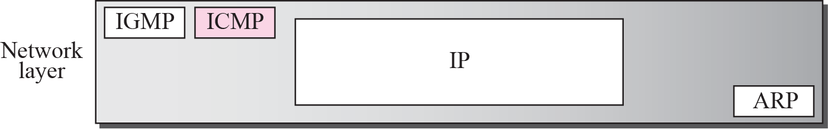
Figure 9.1 Position of ICMP in the network layer

Slide 7
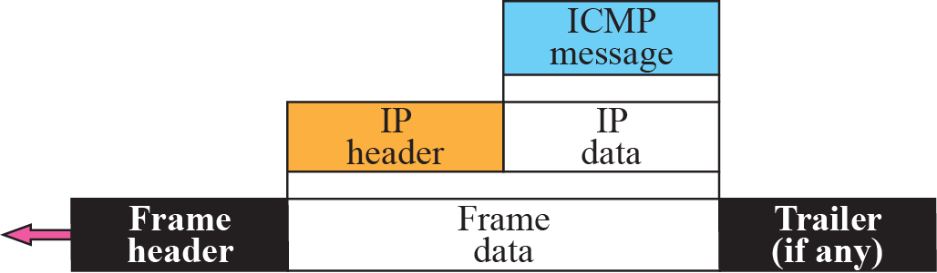
Figure 9.2 ICMP encapsulation

Slide 8
9-2 MESSAGES
ICMP messages are divided into two broad categories:
error-reporting messages
query messages.

Slide 9
error-reporting messages
report problems that a router or a host (destination) may encounter when it processes an IP packet.

Slide 10
The query messages
occur in pairs, help a host or a network manager get specific information from a router or another host. Also, hosts can discover and learn about routers on their network and routers can help a node redirect its messages.

Slide 11
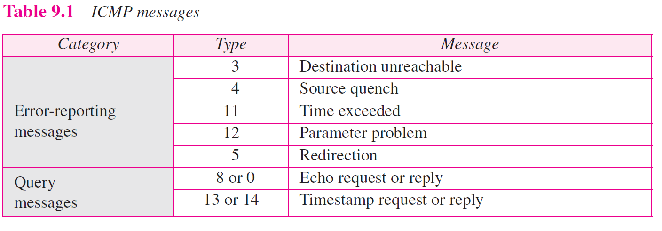

Slide 12
Topics Discussed in the Section
Message Format
Error Reporting Messages
Query Messages
Checksum

Slide 13
ICMP报文格式
首部(8字节)
  前4个字节所有类型的报文相同
  后4个字节与报文类型相关
可变长度的数据部分
  原始数据报的IP首部
  该数据报数据的前8个字节：端口号(UDP,TCP)和序号(TCP)

Slide 14
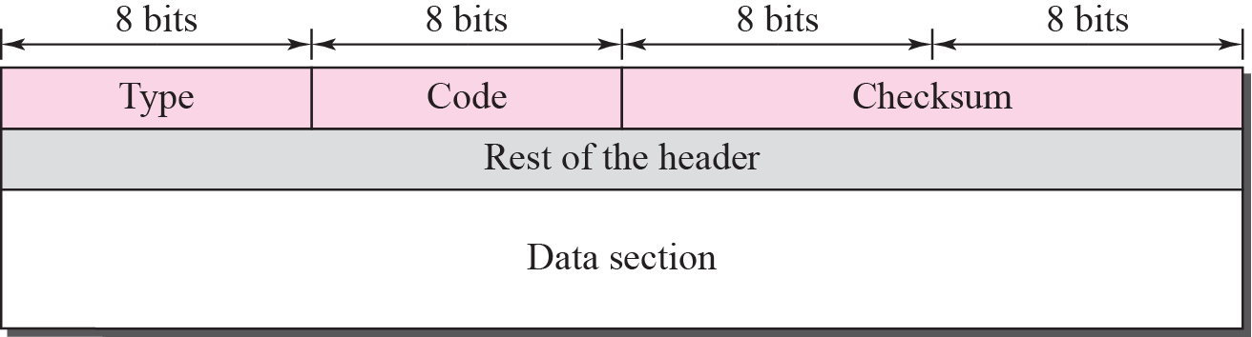
Figure 9.3 General format of ICMP messages

Slide 15
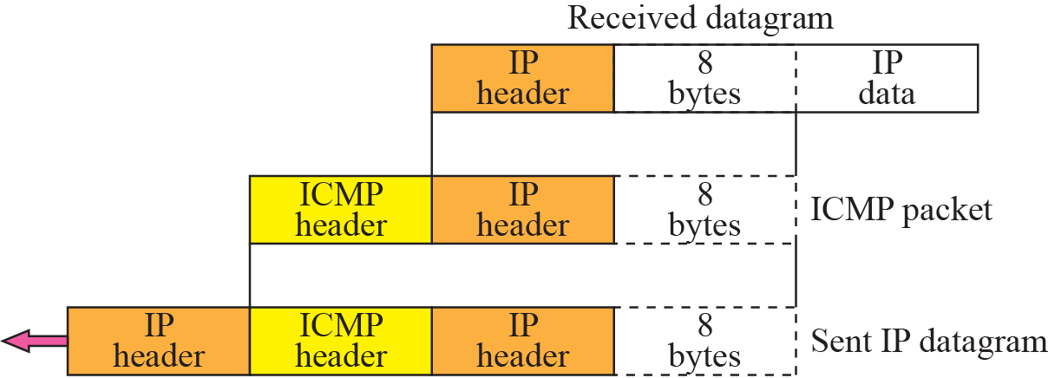
Figure 9.5 Contents of data field for the error message

Slide 16
差错报告报文
ICMP的主要任务：报告差错
ICMP不能纠正错误(差错纠正交给高层协议)
差错报文发给源节点

Slide 17

Note
ICMP always reports error messages to the original source.

Slide 18
差错类型
目的节点(终点)不可达
源节点抑制
超时
参数问题
改变路由

Slide 19
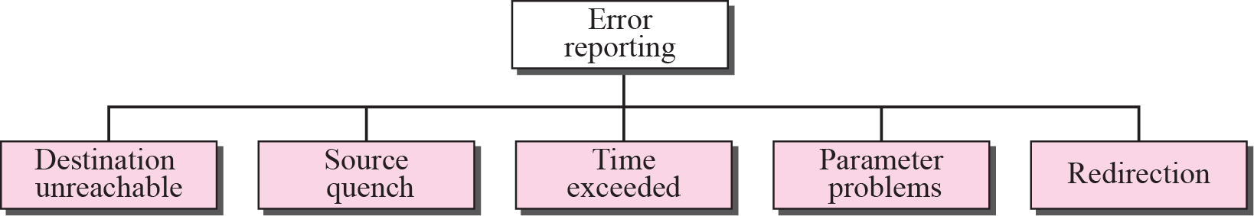
Figure 9.4 Error-reporting messages

Slide 20
不产生ICMP差错报文情形
对于携带ICMP差错报文的数据报，不再产生ICMP差错报文
对于分片的数据报，如果不是第一个分片，则不产生ICMP差错报文
对于具有组播(也称多播)地址的数据报，不产生ICMP差错报文
对于具有特殊地址(如127.0.0.0或0.0.0.0)，不产生ICMP差错报文

Slide 21
目的节点不可达
目的节点不可达
  路由器无法为一个数据报找到路由或主机无法交付一个数据报
  丢弃数据报
差错报告
  路由器或主机向源节点报告“目的节点不可达”

Slide 22
目的节点不可达种类
16种(P210)

Slide 23
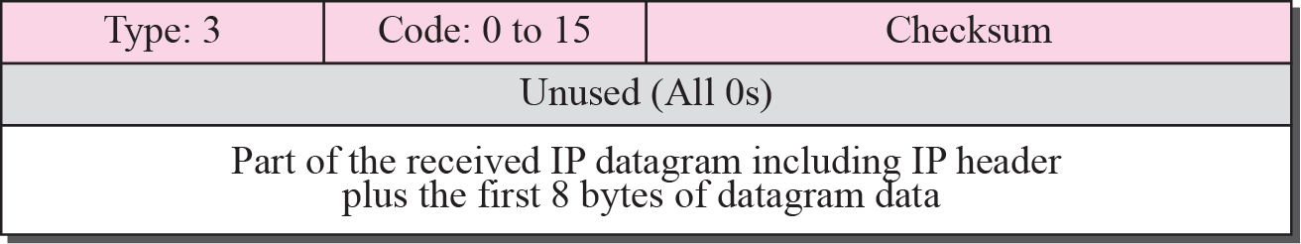
Figure 9.6 Destination-unreachable format

Slide 24
Note
Destination-unreachable messages with codes 2 or 3 can be created only by the
destination host.
Other destination-unreachable messages can be created only by routers.

Slide 25
不报告目的节点不可达情形
若数据报通过以太网，路由器无法得知该数据报是否被交付(以太网不提供确认机制)

Slide 26
Note
A router cannot detect all problems that prevent the delivery of a packet.

Slide 27
源节点抑制
当路由器或主机因拥塞而丢弃数据报时，向该数据报的源节点发送“源节点抑制”报文
作用
  通知源节点数据报已被丢弃
  警告源节点，在路径中的某处出现了拥塞，源节点必须放慢(抑制)发送过程

Slide 28
Note
There is no flow-control or congestion-control mechanism in the IP protocol.

Slide 29
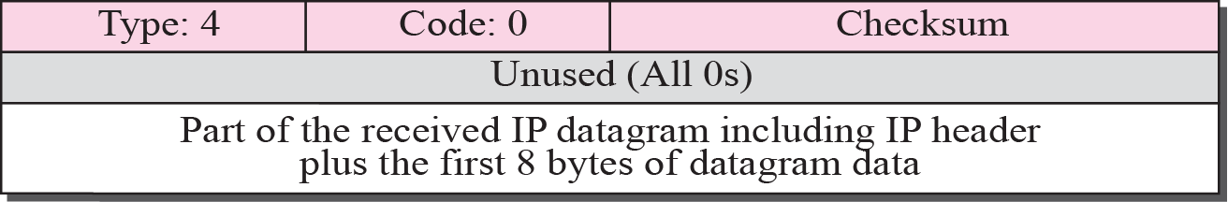
Figure 9.7 Source-quench format

Slide 30
Note
A source-quench message informs the source that a datagram has been discarded due to congestion in
a router or the destination host.
The source must slow down the sending of datagrams until the congestion is relieved.

Slide 31
Note
One source-quench message is sent for each datagram that is discarded due
to congestion.

Slide 32
超时
数据报TTL字段值变成0
目的节点在规定的时间内没有收到一个分组的所有分片

Slide 33
Note
Whenever a router decrements a datagram with a time-to-live value to zero, it discards the datagram and
sends a time-exceeded message to the original source.

Slide 34
Note
When the final destination does not receive all of the fragments in a
set time, it discards the received fragments and sends a
time-exceeded message to
the original source.

Slide 35
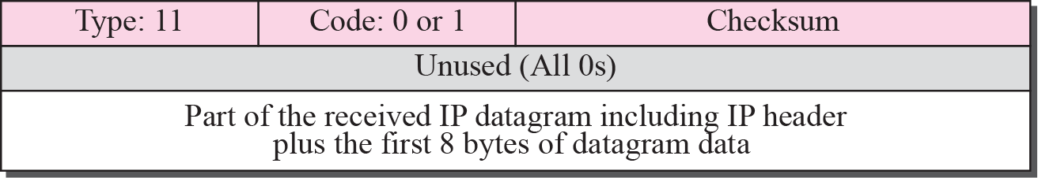
Figure 9.8 Time-exceeded message format

Slide 36
Note
In a time-exceeded message, code 0 is used only by routers to show that the value of the time-to-live field is zero.
Code 1 is used only by the destination host to show that not all of
the fragments have arrived
within a set time.

Slide 37
参数问题
若路由器或目的节点发现数据报首部中的字段值出错(二义性)，丢弃该数据报
向源节点报告“参数问题”

Slide 38
Note
A parameter-problem message can be created by a router or the destination host.

Slide 39
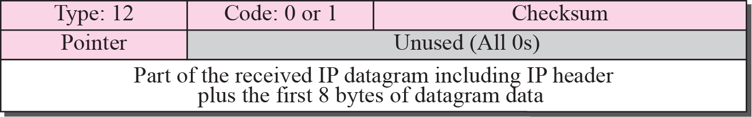
Figure 9.9 Parameter-problem message format

Slide 40
改变路由
发送节点(主机)通常使用静态路由
当路由器收到发送节点发来的数据报，并发现存在更好的路由(即发送节点应发给另一个路由器)，路由器向发送节点发送“改变路由”报文，让发送节点更新路由表
路由器并不丢弃数据报，而是将该数据报发送给更合适的路由器

Slide 41
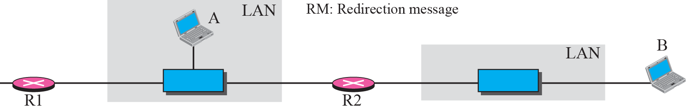
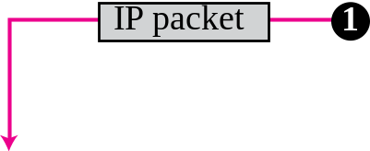

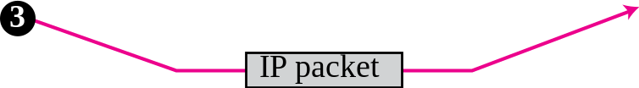
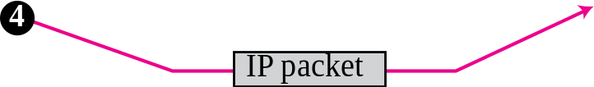
Figure 9.10 Redirection concept

Slide 42
Note
A host usually starts with a small routing table that is gradually augmented and updated.
One of the tools to accomplish this
is the redirection message.

Slide 43
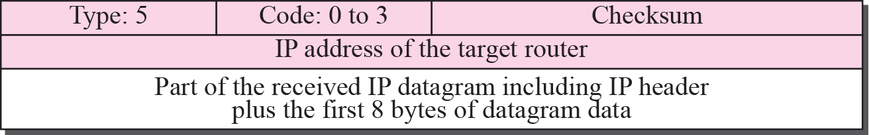
Figure 9.11 Redirection message format

Slide 44
Note
A redirection message is sent from a router to a host on the same local network.

Slide 45
查询
对某些网络问题进行诊断
目前尚在使用的两对查询报文
  回送请求与回送应答
  时间戳请求与时间戳应答

Slide 46
Note
An echo-request message can be sent by a host or router.
An echo-reply message is sent
by the host or router that receives
an echo-request message.

Slide 47
Note
Echo-request and echo-reply messages can be used by network managers to check the operation of the IP protocol.

Slide 48
Note
Echo-request and echo-reply messages can test the reachability of a host.
This is usually
done by invoking the ping command.

Slide 49
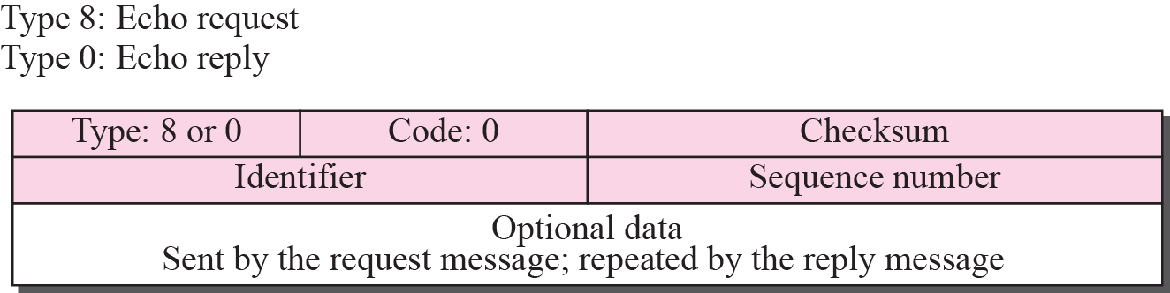
Figure 9.12 Echo-request and echo-reply message

Slide 50
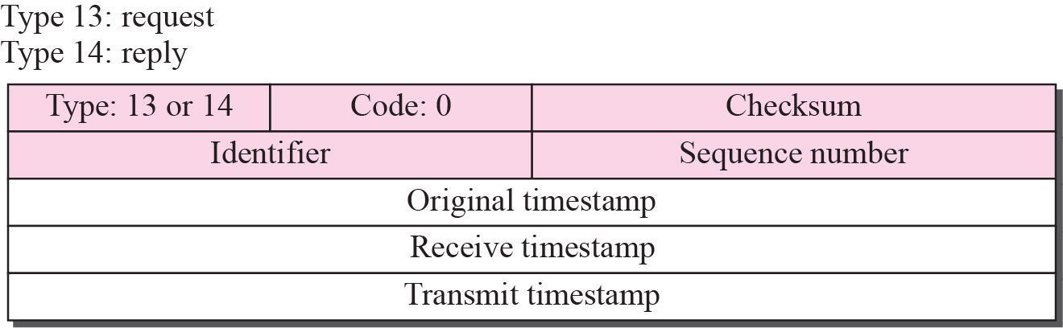
Figure 9.13 Timestamp-request and timestamp-reply message format

Slide 51
Note
Timestamp-request and timestamp-reply messages can be used to calculate the
round-trip time between a source and a destination machine even if their
clocks are not synchronized.

Slide 52
Note
The timestamp-request and timestamp-reply messages can be used to synchronize two clocks in two
machines if the exact one-way
time duration is known.

Slide 53
校验和
在ICMP中，校验和的计算覆盖了整个报文(首部和数据)

Slide 54
Example 9.1
Figure 9.14 shows an example of checksum calculation for a simple echo-request message (see Figure 9.12). We randomly chose the identifier to be 1 and the sequence number to be 9. The message is divided into 16-bit (2-byte) words. The words are added together and the sum is complemented. Now the sender can put this value in the checksum field.

Slide 55
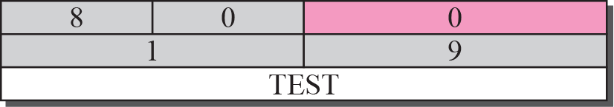

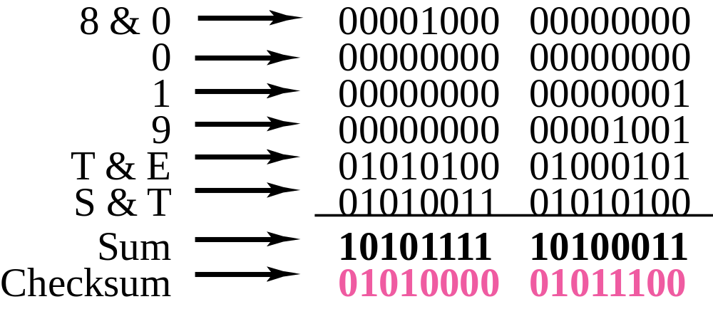
Figure 9.14 Example of checksum calculation

Slide 56
9-3 DEBUGGING TOOLS
There are several tools that can be used in the Internet for debugging. We can find if a host or router is alive and running. We can trace the route of a packet. We introduce two tools that use ICMP for debugging: ping and traceroute. We will introduce more tools in future chapters after we have discussed the corresponding protocols.

Slide 57
Topics Discussed in the Section
Ping
Traceroute

Slide 58
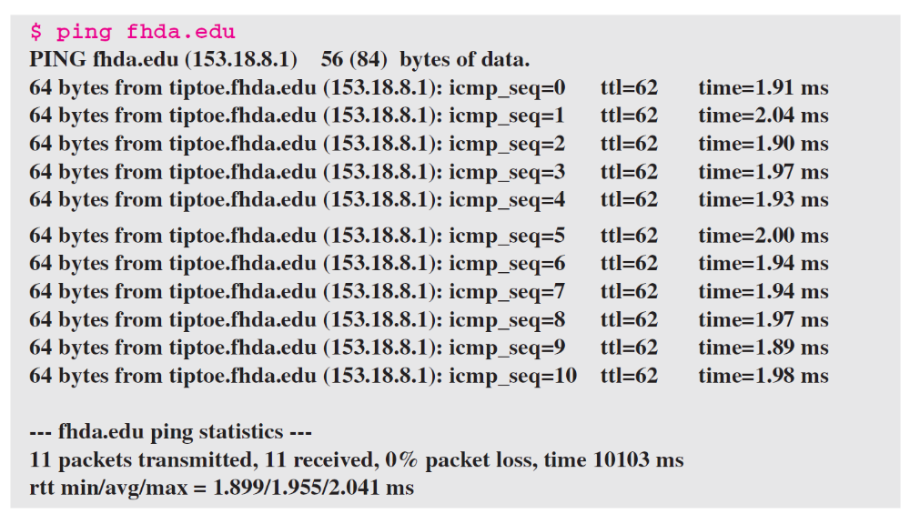
Example 9.2
We use the ping program to test the server fhda.edu. The result is shown below:

Slide 59
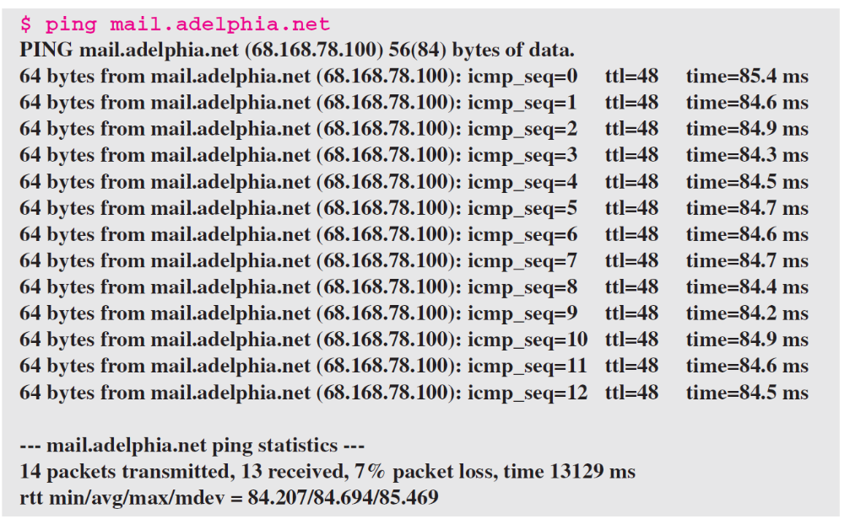
Example 9.3
For the second example, we want to know if the adelphia.net mail server is alive and running. The result is shown below: Note that in this case, we sent 14 packets, but only 13 have been returned. We may have interrupted the program before the last packet, with sequence number 13, was returned.

Slide 60
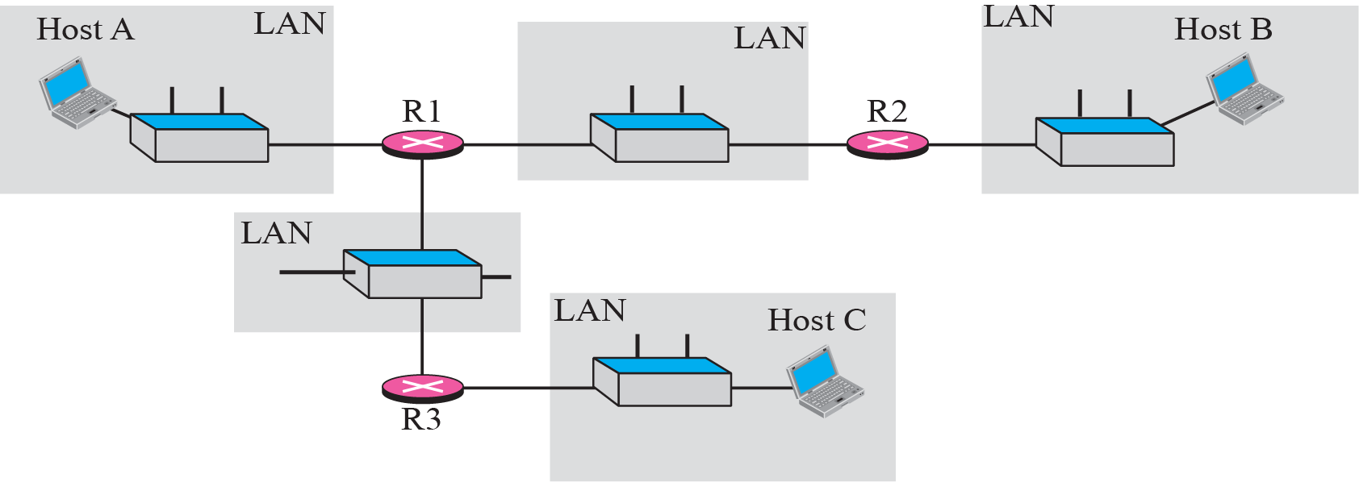
Figure 9.15 The traceroute program operation

Slide 61
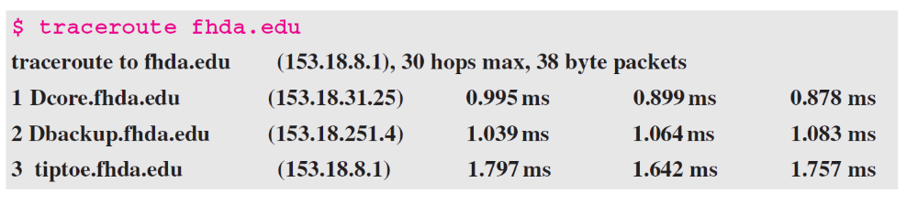
Example 9.4
We use the traceroute program to find the route from the computer voyager.deanza.edu to the server fhda.edu. The following shows the result.

Slide 62
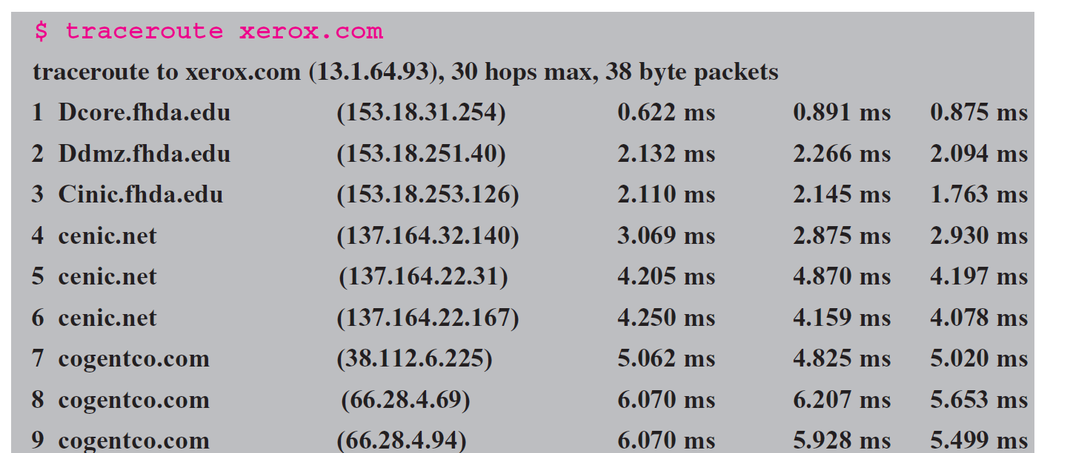
Example 9.5
In this example, we trace a longer route, the route to xerox.com. The following is a partial listing.

Slide 63
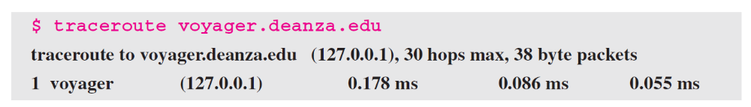
Example 9.6
An interesting point is that a host can send a traceroute packet to itself. This can be done by specifying the host as the destination. The packet goes to the loopback address as we expect.

Slide 64
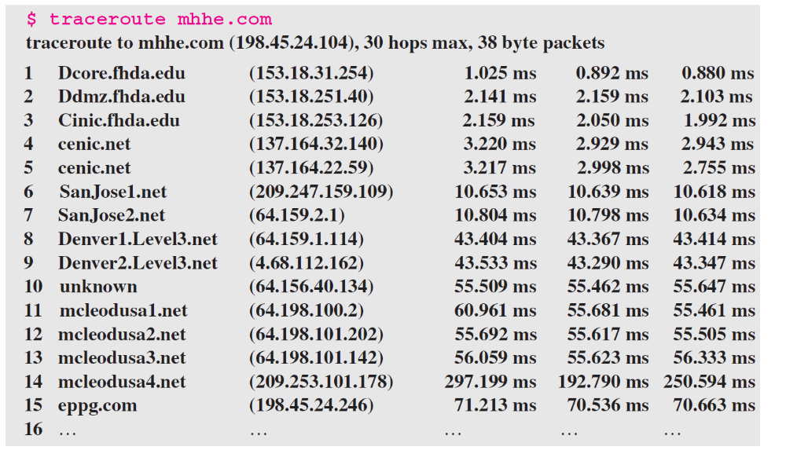
Example 9.7
Finally, we use the traceroute program to find the route between fhda.edu and mhhe.com (McGraw-Hill server). We notice that we cannot find the whole route. When traceroute does not receive a response within 5 seconds, it prints an asterisk to signify a problem (not the case in this example), and then tries the next hop.

Slide 65
9-4 ICMP PACKAGE
To give an idea of how ICMP can handle the sending and receiving of ICMP messages, we present our version of an ICMP package made of two modules: an input module and an output module.

Slide 66
Topics Discussed in the Section
Input Module
Output Module

Slide 67
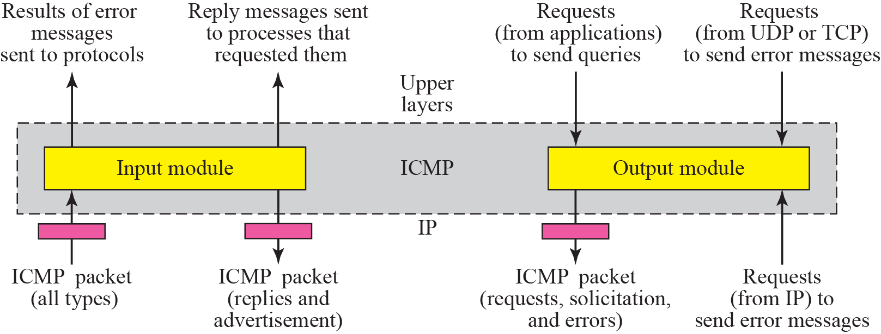
Figure 9.16 ICMP package

Slide 68
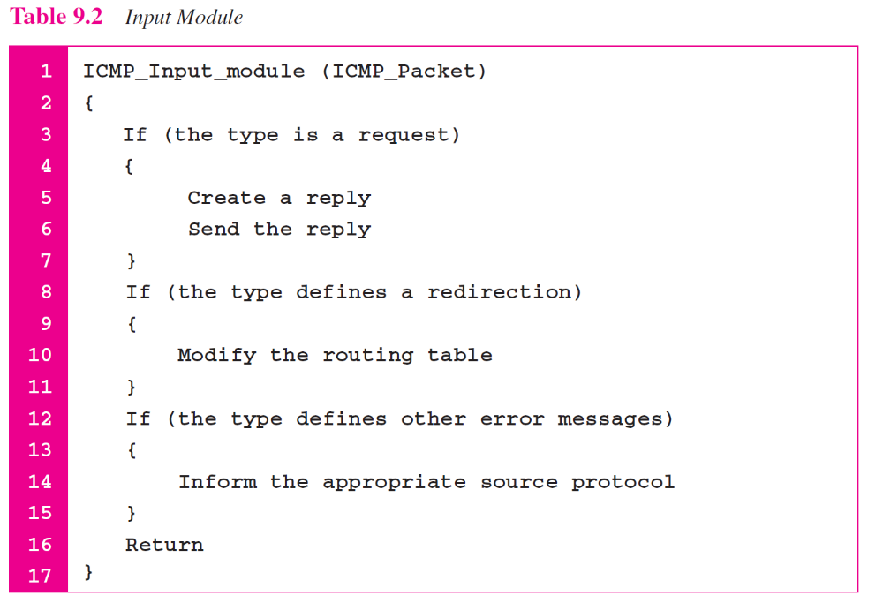

Slide 69
